Slide 1
Datathon-MSG Team 2 - Shocking Team
Price Shock Predictor: News-driven Key Factor Extraction Challenge
11.2023

Slide 2
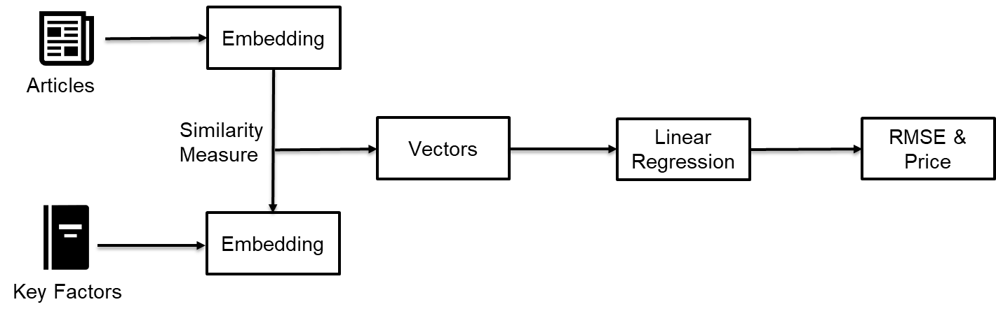
Overview
11.2023

Slide 3

Crawling Internet Data - Spider
11.2023

Slide 4
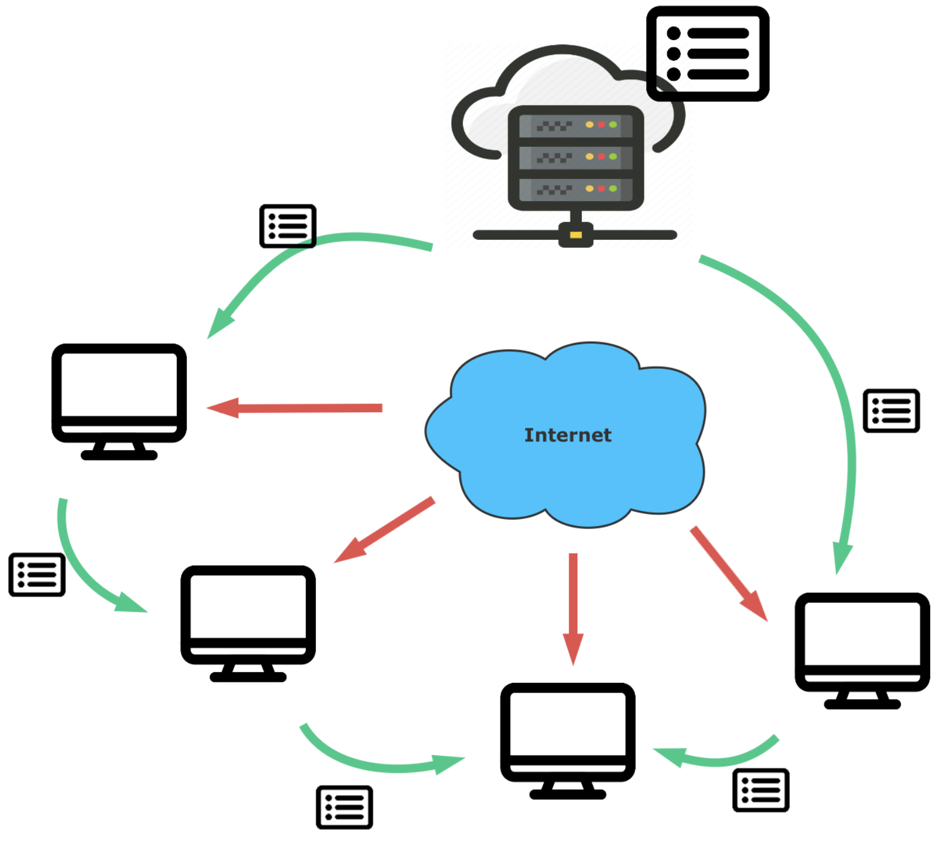
Crawling Internet Data - Spider
11.2023

Slide 5
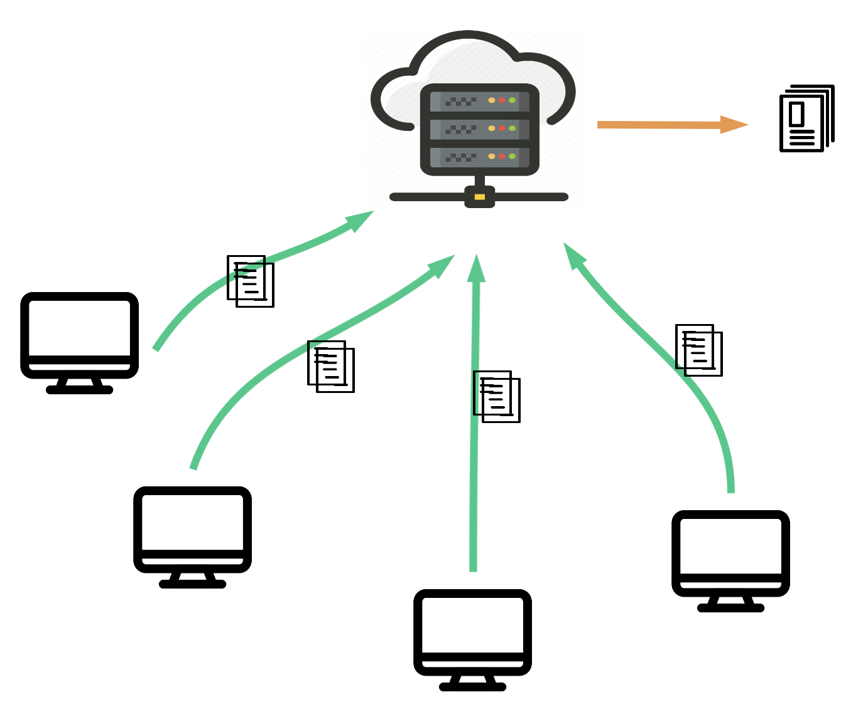
Crawling Internet Data - Spider
11.2023

Slide 6
Overview
11.2023

Slide 7
Filter Articles
Filter
11.2023

Slide 8
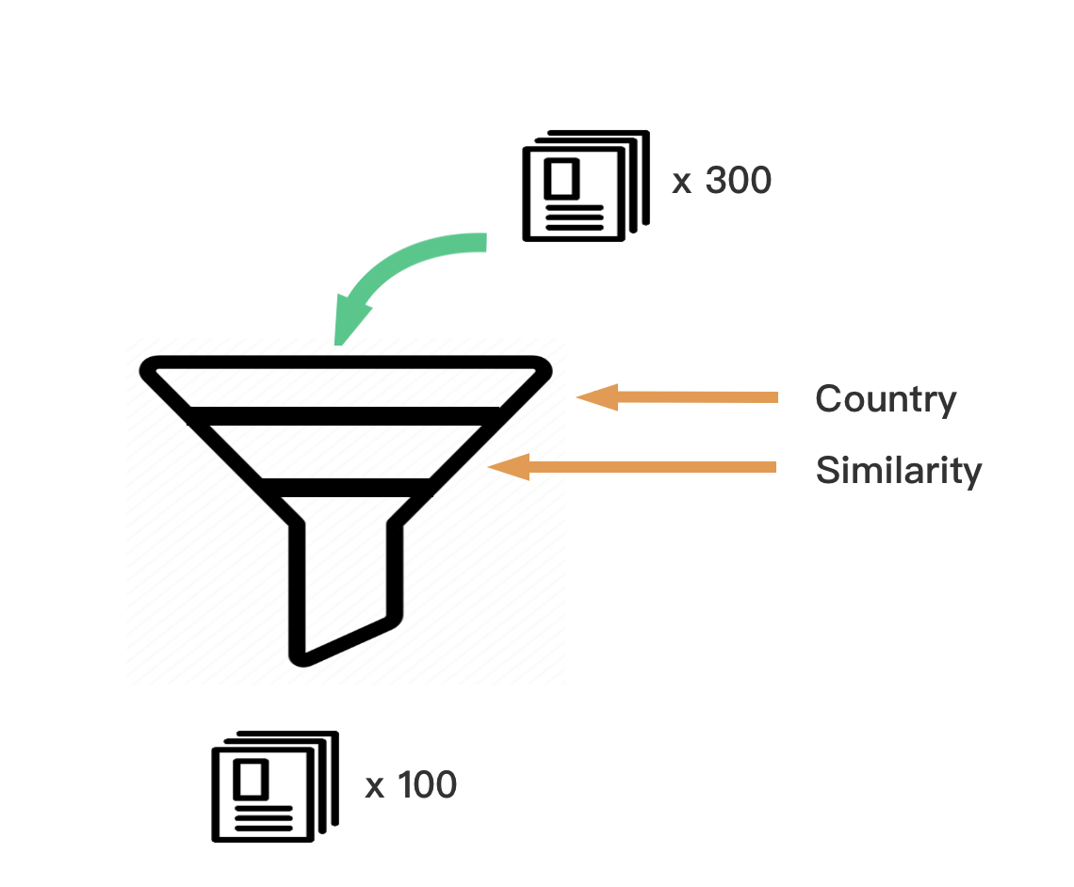
Filter Articles
11.2023

Slide 9
Overview
11.2023

Slide 10
Sentence Embedding
11.2023

Slide 11
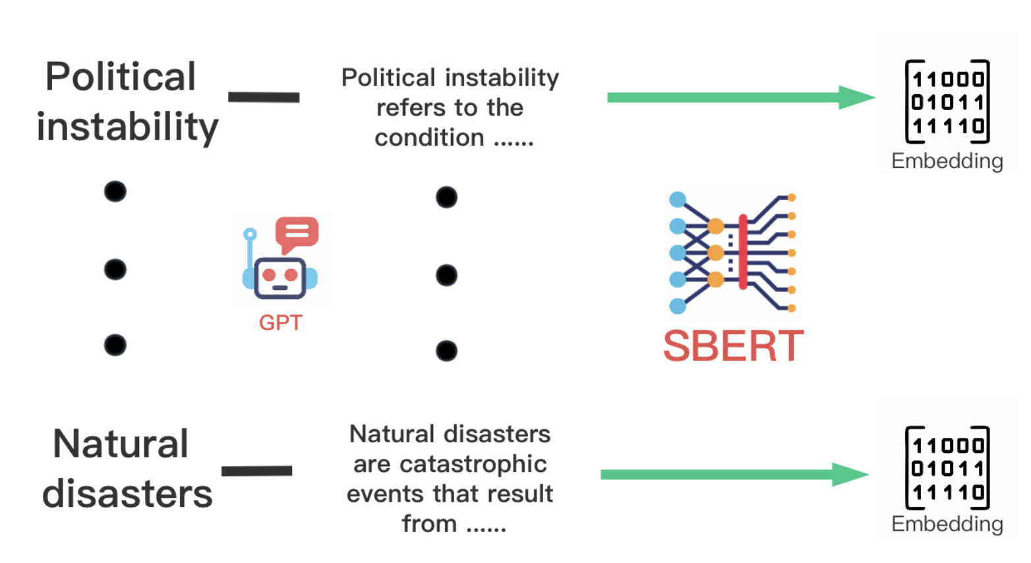
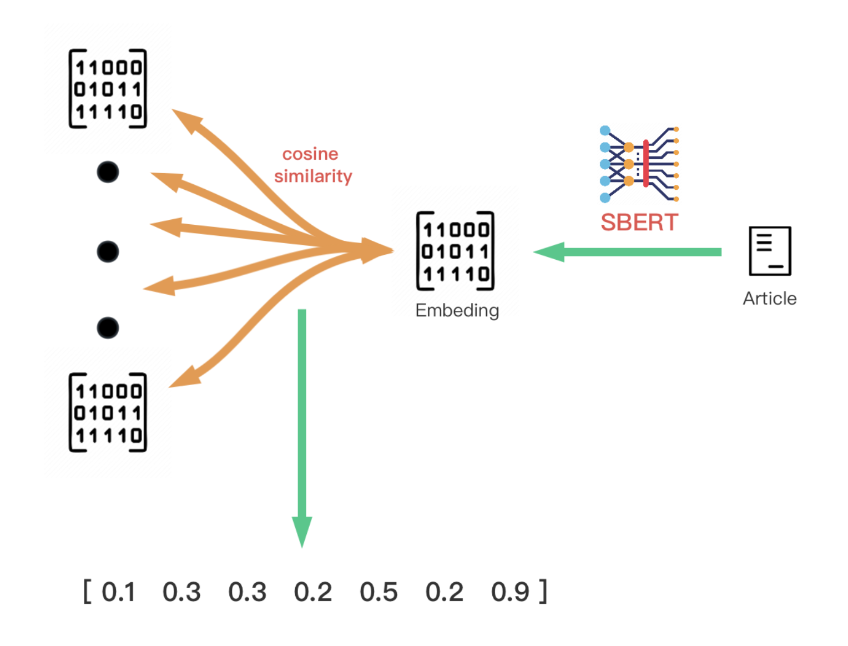
Sentence Embedding
11.2023

Slide 12
Sentence Embedding
11.2023

Slide 13
Overview
11.2023

Slide 14
Vectors
11.2023

Slide 15
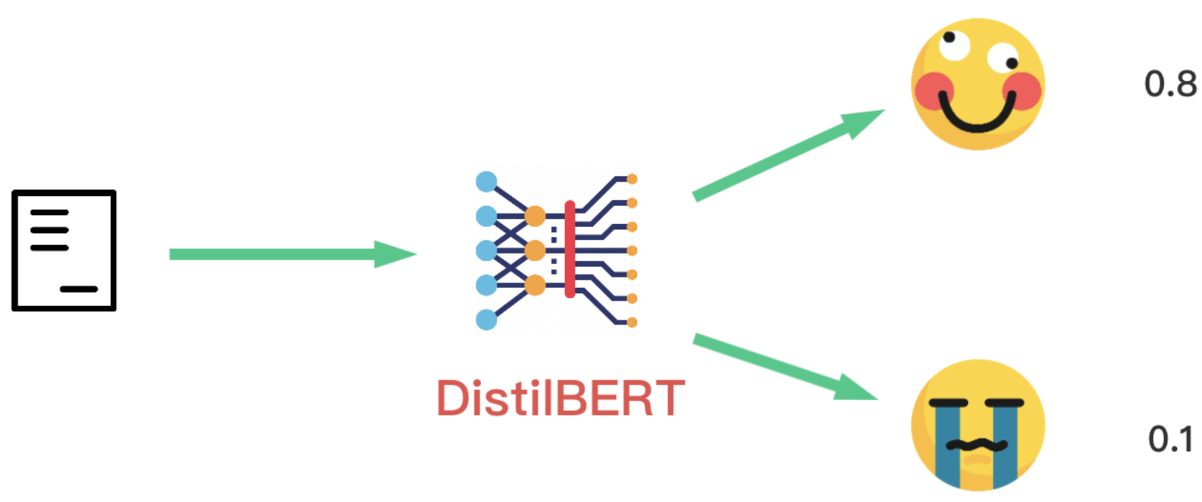
Vectors - Sentiment Analysis
11.2023

Slide 16
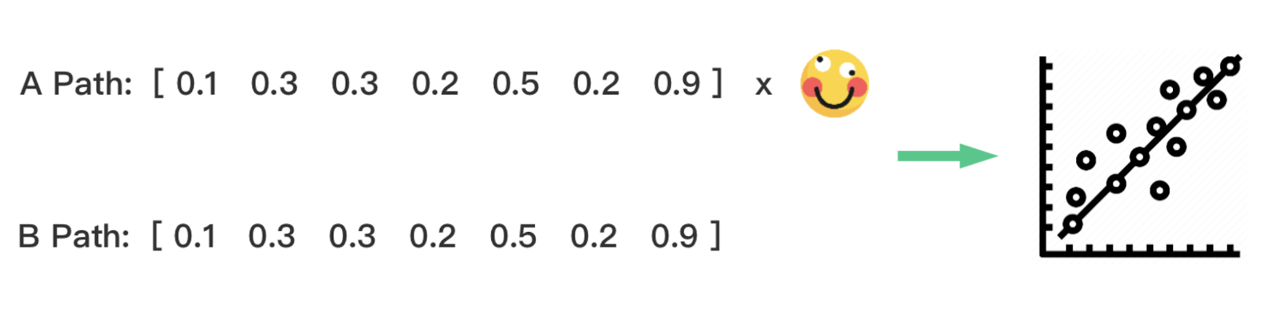
Vectors - Sentiment Analysis
11.2023

Slide 17
Overview
11.2023

Slide 18
Vectors
DNN
LSTM
11.2023

Slide 19
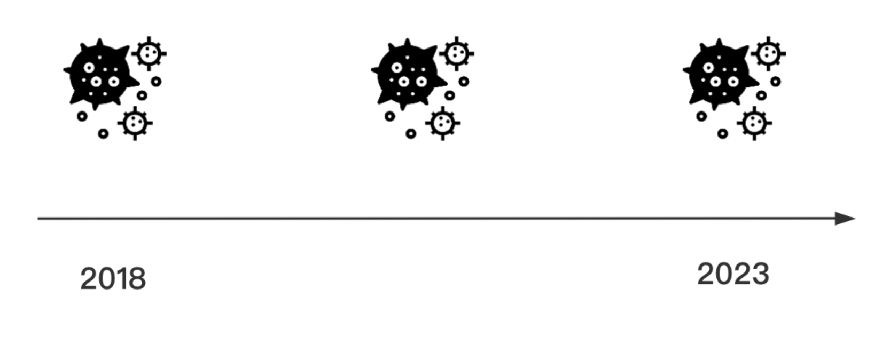
Vectors - LSTM & DNN
11.2023

Slide 20
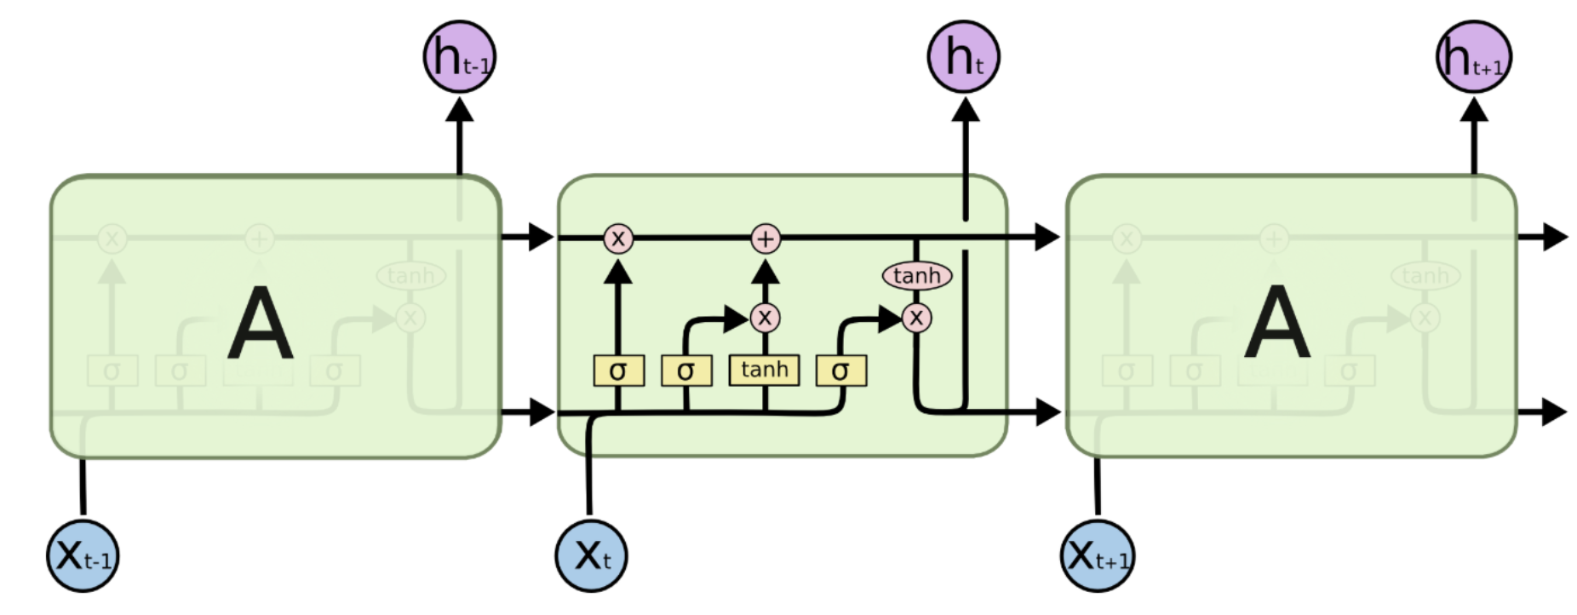
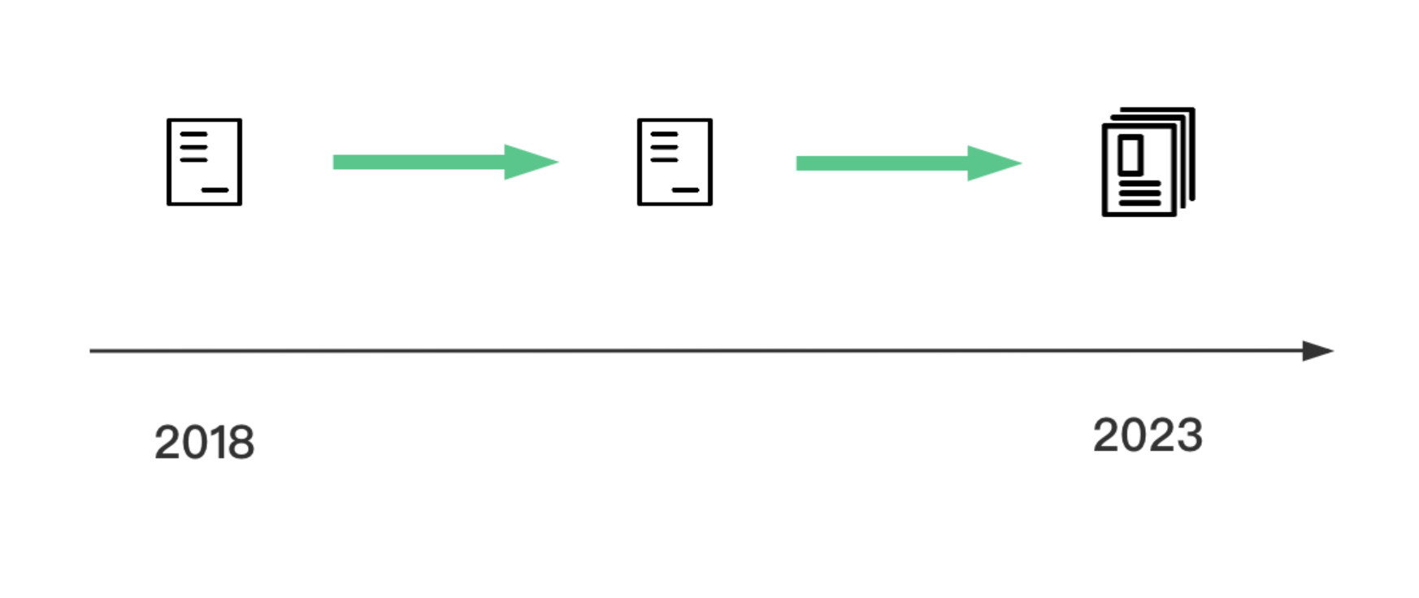
Vectors - LSTM & DNN
11.2023

Slide 21
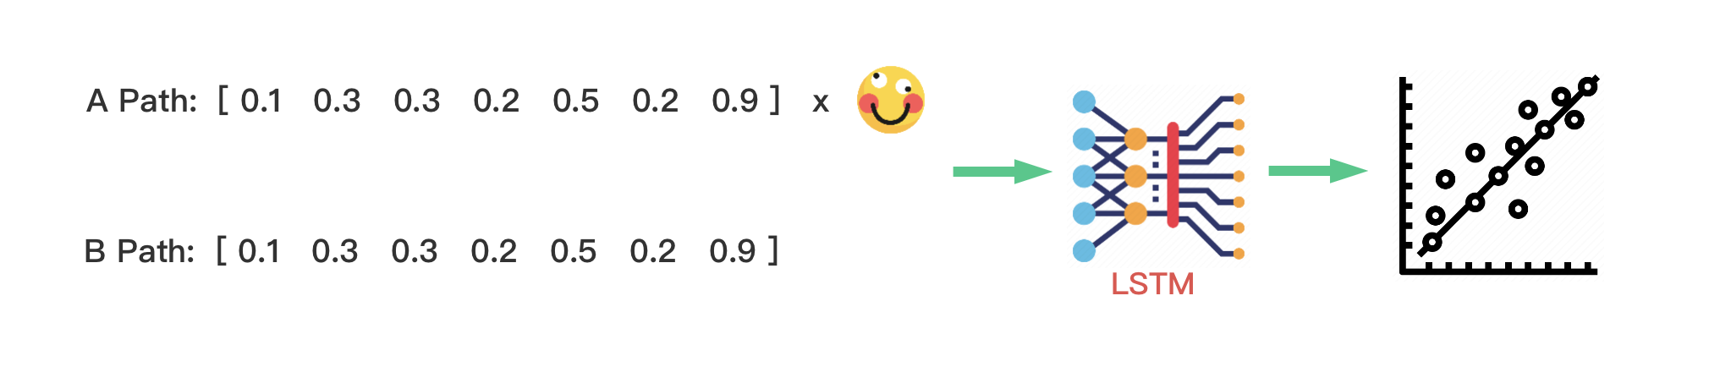
Vectors - LSTM & DNN
11.2023

Slide 22
Overview
11.2023

Slide 23
Linear Regression
11.2023

Slide 24
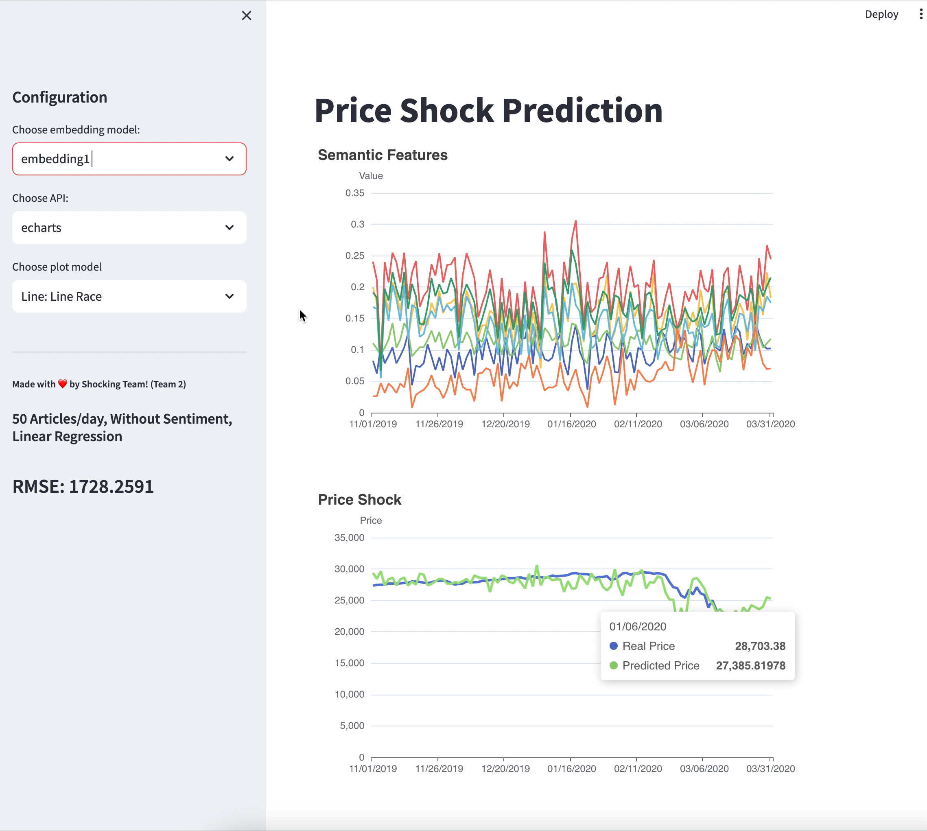
Linear Regression
11.2023

Slide 25
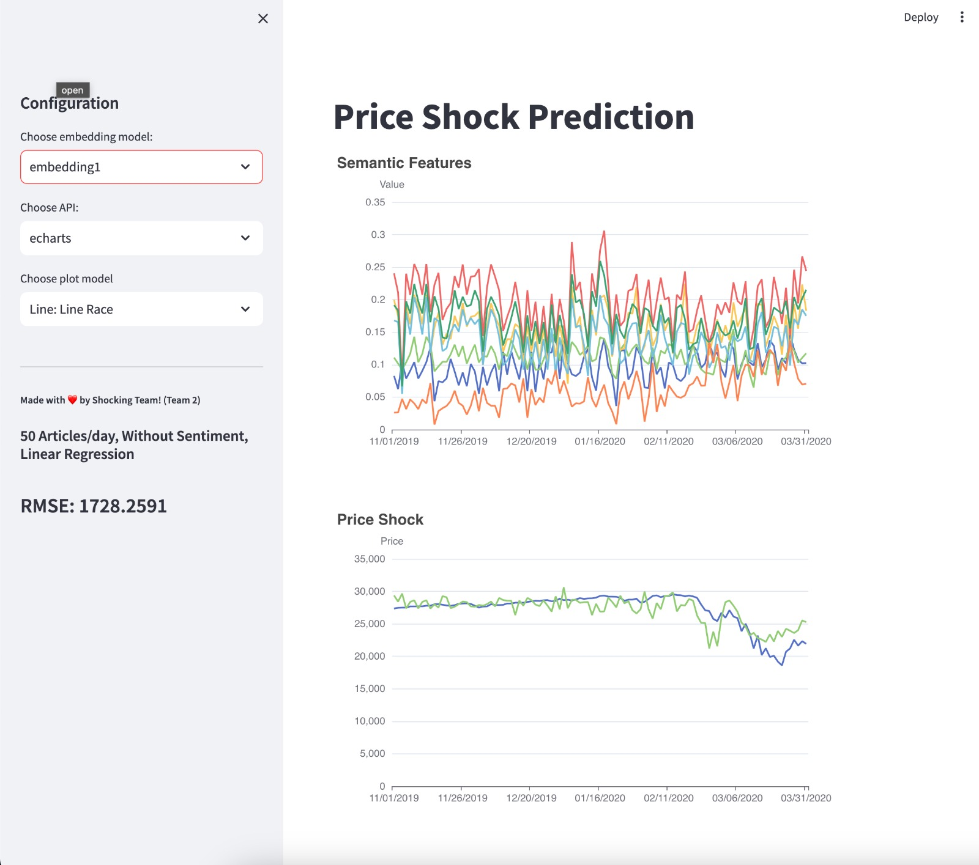
Linear Regression
11.2023

Slide 26
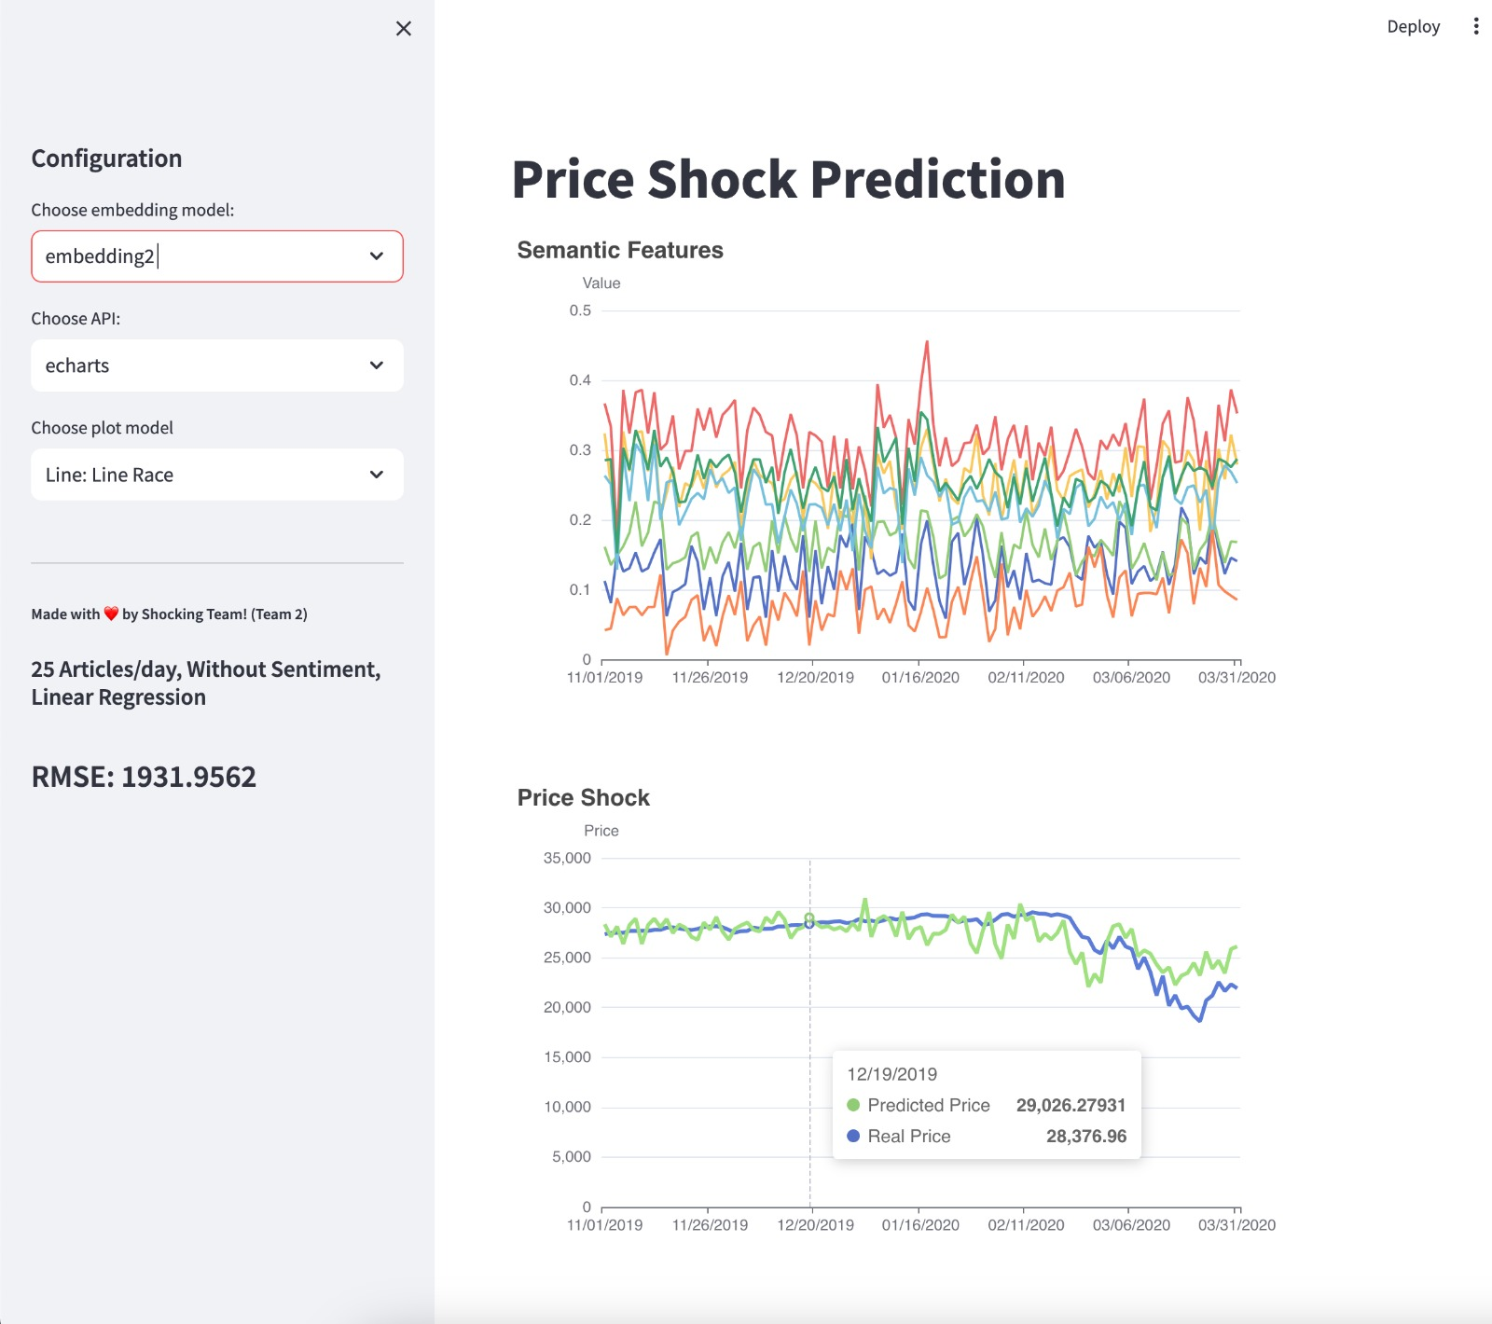
Linear Regression
11.2023

Slide 27
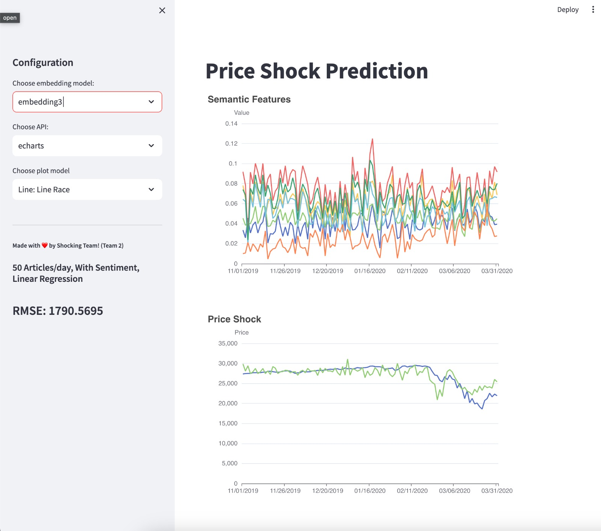
Linear Regression
11.2023

Slide 28
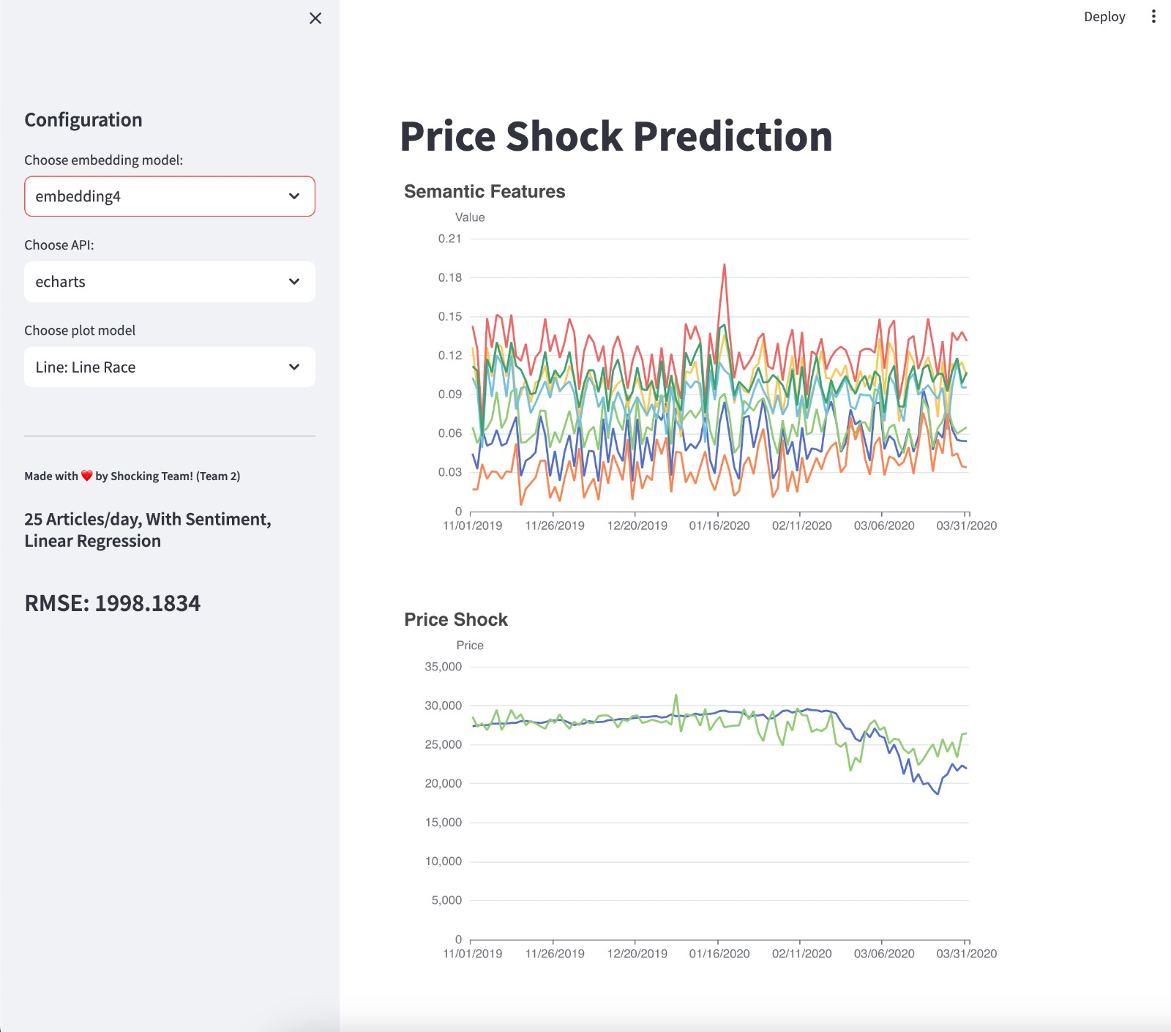
Linear Regression
11.2023

Slide 29
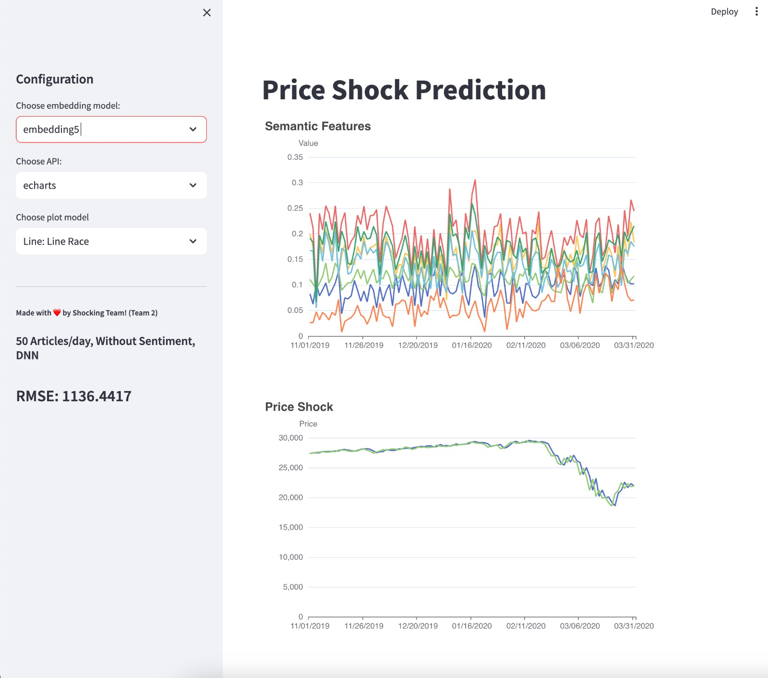
Linear Regression
11.2023

Slide 30
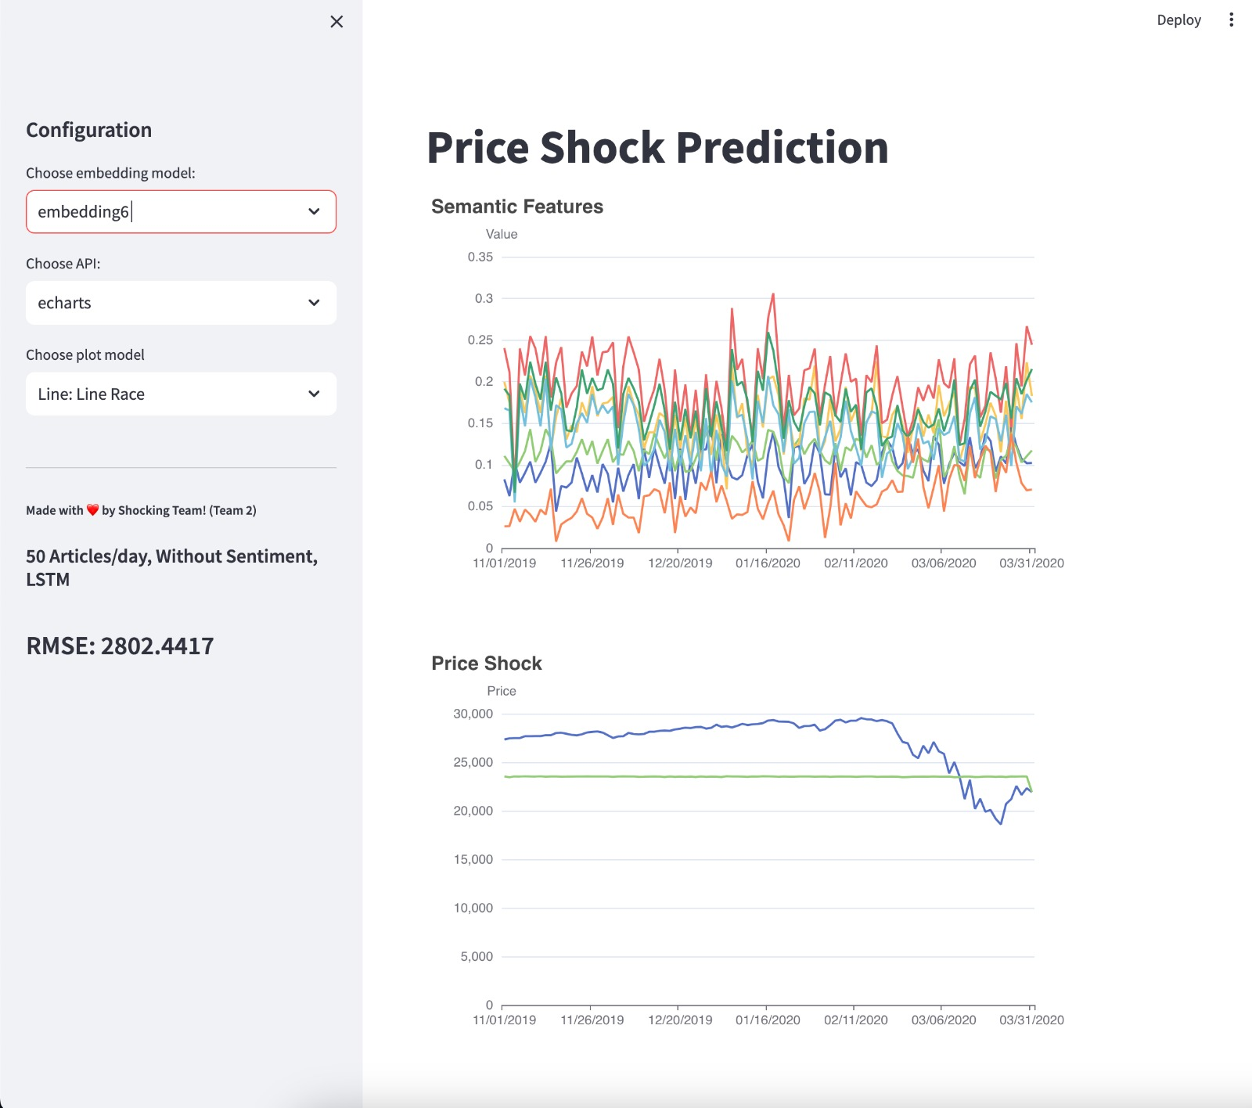
Linear Regression
11.2023

Slide 31
Thanks for your attention
Questions?
11.2023

